Slide 1
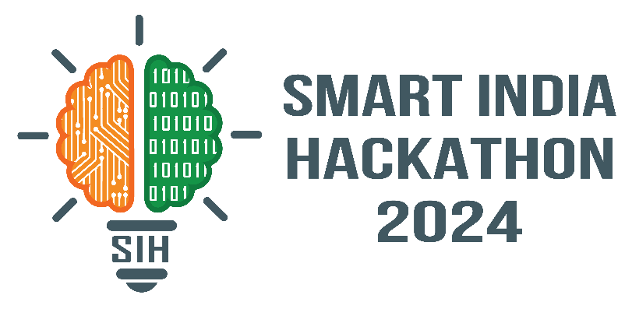
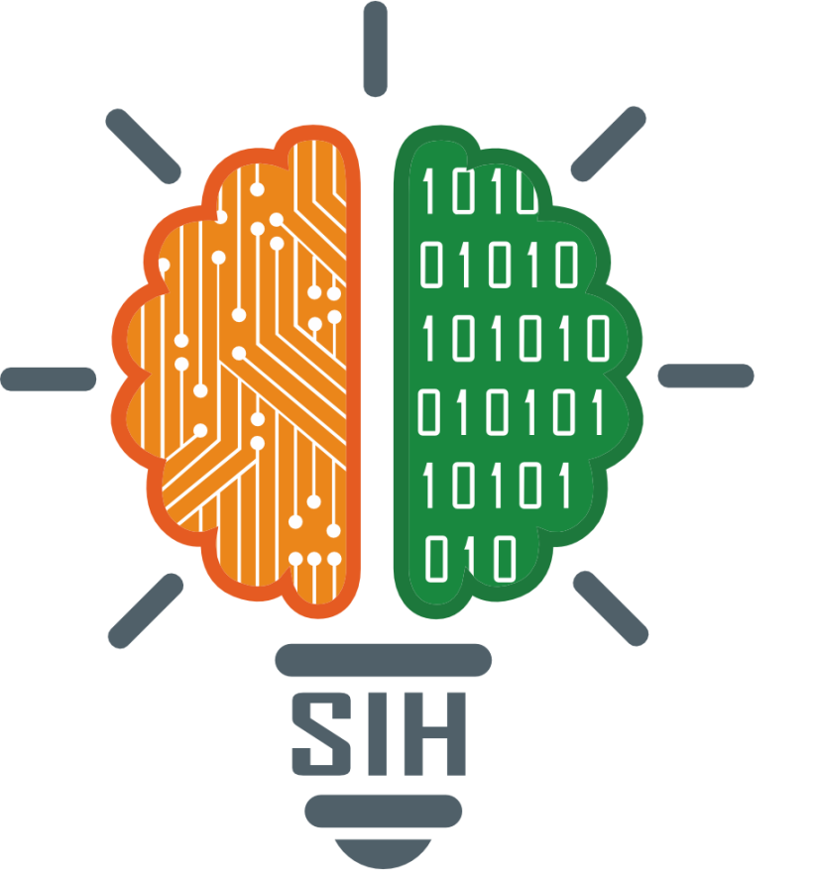
SMART INDIA HACKATHON 2024
Problem Statement ID – SIH1692
Problem Statement Title-
Forecasting Future Water Requirements and Assessing Storage Capacities in Reservoirs
Theme- Smart Education
PS Category- Software
Team Name – Drips-out

Slide 2
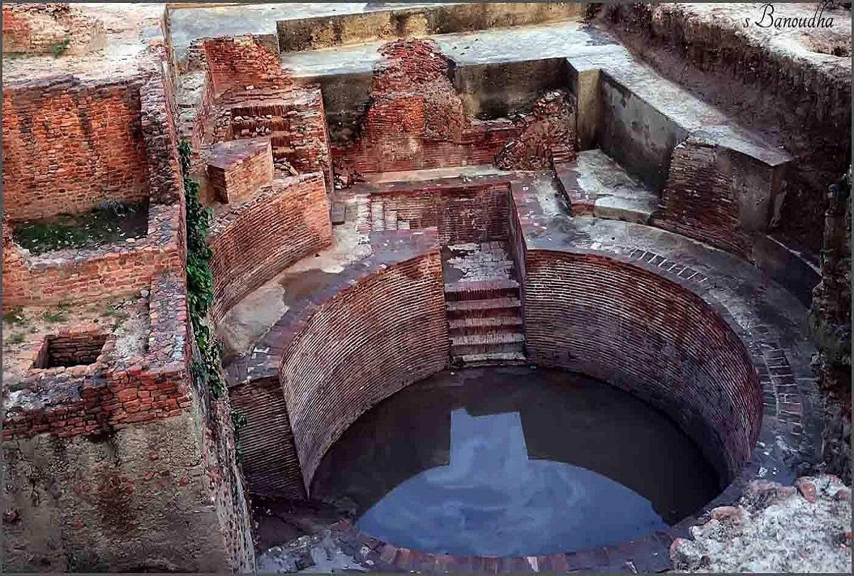
HydroScape “Mapping the future of water sustainability”
Drips-out
Water Supply Mapping:
Identify reservoir connections to districts and analyze capacities.
2. Water Usage Analysis:
Evaluate agricultural, industrial, and domestic water demands,
including ecological needs.
Water footprints description.
Data collection, processing and Integration
3. Water Demand & Sectoral Analysis:
Calculate water demand by sector and assess irrigation and consumption patterns through AI-driven models.
4. Strategic Allocation & Management:
Develop AI models, simulate extreme scenarios, and use Power BI for visualization.

Slide 3
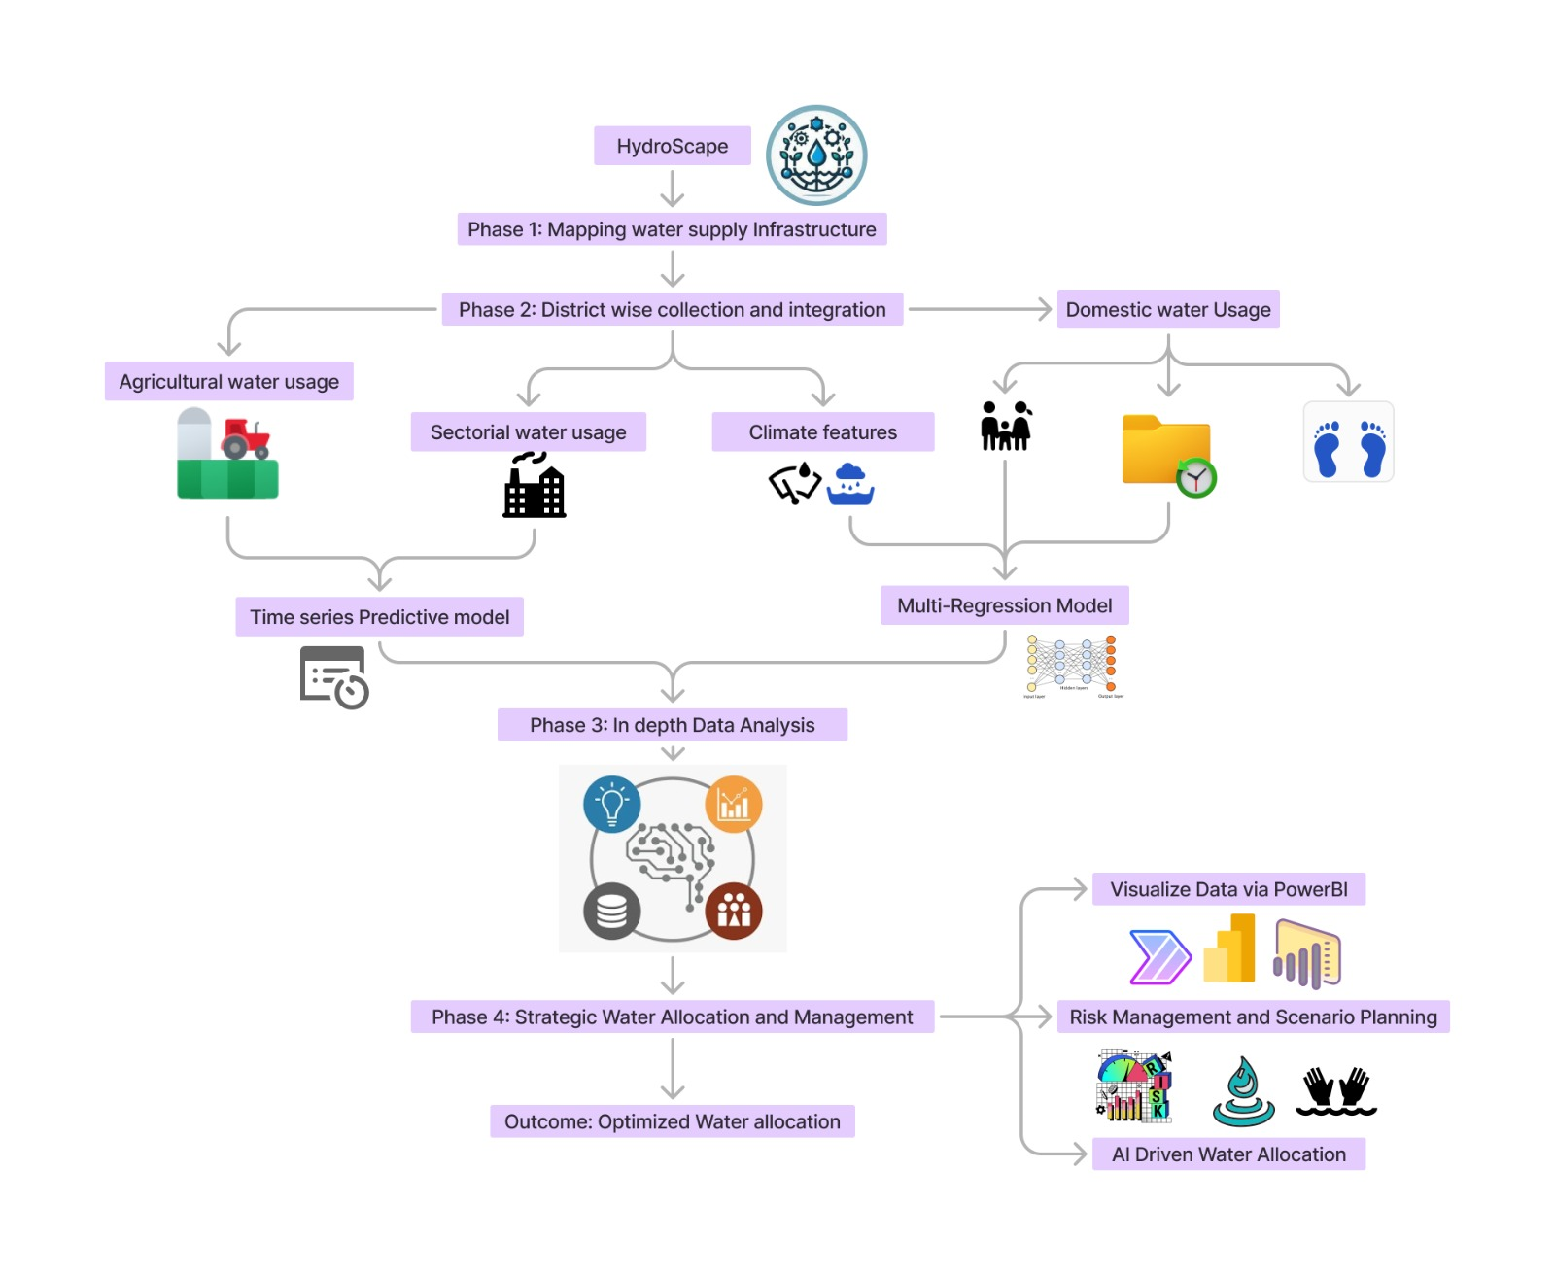
TECHNICAL APPROACH
Drips-out
Technical stack :
Data Collection and Processing: Beautiful Soup
Selenium, Microsoft Excel
Data Analysis and Modeling: Python, NumPy, Pandas,
Scikit-Learn
Statsmodels
Time-series Model (SARIMA)
Multi-Regression + Random Forest
Mixed Integer Programming (MIP)
Data Visualization and Reporting:
PostgreSQL + Power BI + Selenium
Power BI, Matplotlib
Web Application Interface:
Flask
HTML, CSS and JavaScript
Machine Learning and AI: TensorFlow / Keras.

Slide 4
FEASIBILITY AND VIABILITY
Drips-out
1. Analysis of the feasibility of the idea:
Adaptable to various sectors and needs.
Historical data on reservoirs, ground water and their capacities is crucial for accurate modeling.
Water Footprints knowledge and conservation tips that is beneficial for users and feasibly decisive for the policymakers
2. Potential Challenges and risks:
Dynamic Adaptation to evolving water usage patterns.
Integrating indigenous knowledge with modern predictive models.
3. Strategies for overcoming these challenges
Geo-Ethnographic Data Fusion for Water Resource Management.
Continuously update models with new data and insights.
Integration of Explainable AI for better decision/policy making.

Slide 5
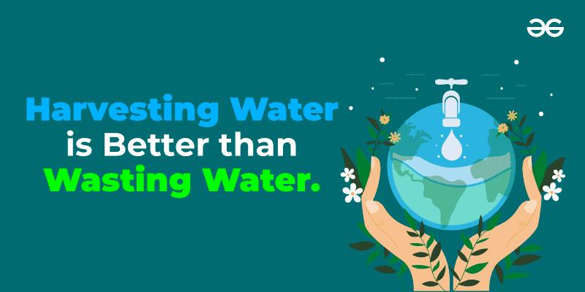

IMPACT AND BENEFITS
Drips-out
1. Potential impact on the target audience:
Ensures equitable water distribution and prevents shortages.
Aids in long-term water management planning and risk mitigation.
2. Benefits of the solution:
Preservation of cultural and environmental values.
Holistic integration of cultural practices with modern Water Management techniques.
Image source: Google

Slide 6
RESEARCH AND REFERENCES
Drips-out
Research was done on the applications of the problem statements and the target group that is focused in the proposed solution.
Datasets of some of the many parts were curated which became the base of the data analysis.
Machine Learning models were duly related to the output needed.
References:
India Water Resources Information System (India WRIS): https://indiawris.gov.in/wris/#/
Petri, B. Yuce, A. Kwan and Y. Rezgui, "An Intelligent Analytics System for Real-Time Catchment Regulation and Water Management," in IEEE Transactions on Industrial Informatics, vol. 14, no. 9, pp. 3970-3981, Sept. 2018, doi: 10.1109/TII.2017.2782338
P. Ai, C. Xiong, K. Li, Y. Song, S. Gong and Z. Yue, "Effect of Data Characteristics Inconsistency on Medium and Long-Term Runoff Forecasting by Machine Learning," in IEEE Access, vol. 11, pp. 11601-11612, 2023, doi: 10.1109/ACCESS.2023.3241995.

